Slide 1
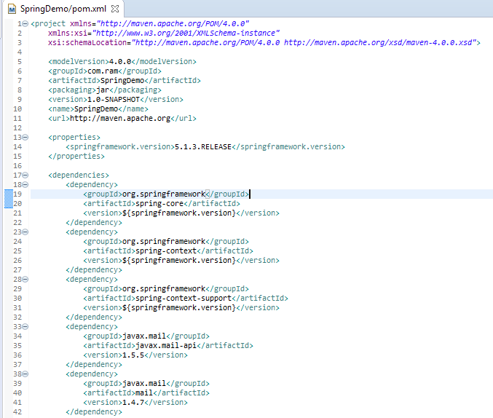
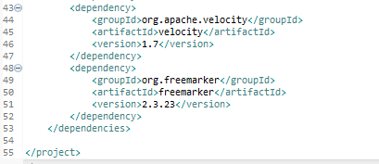
Spring Email using Freemarker Template library
Spring Email support is built upon JavaMail API, which must be found on class path. In this example, we did so by including API javax.mail.javax.mail-api & implementation javax.mail.mail in our pom.xml. Spring’s EMail support related stuff is packaged under spring-context-support.

Slide 2
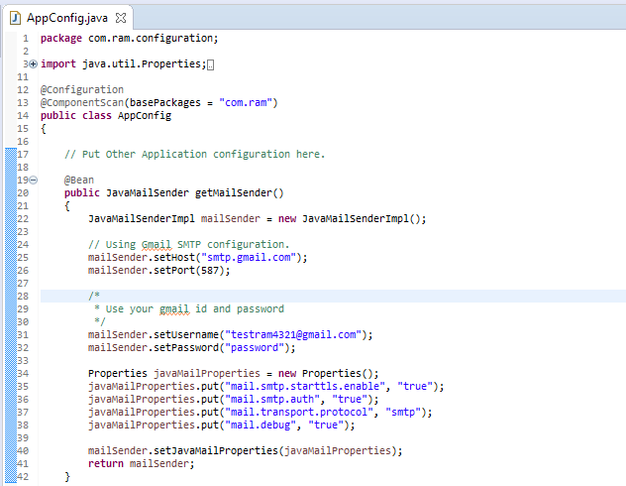
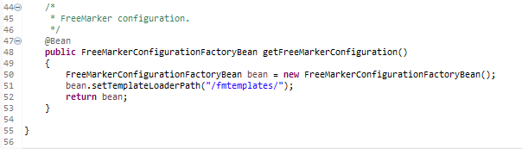
Spring Email using Freemarker Template library

Slide 3
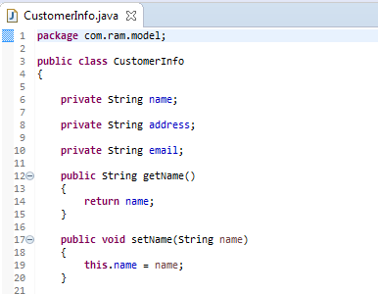
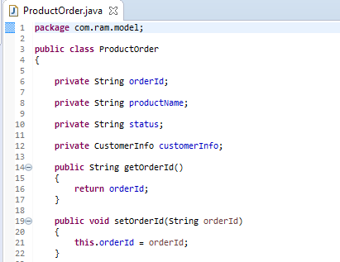
Spring Email using Freemarker Template library

Slide 4
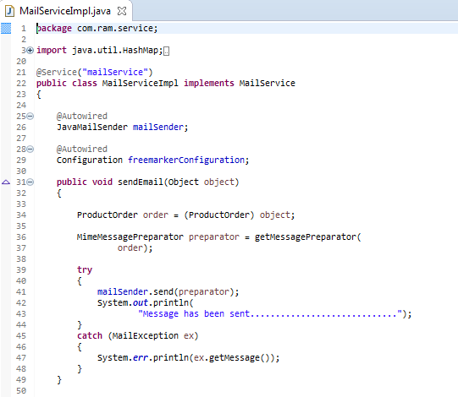
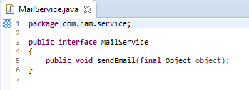
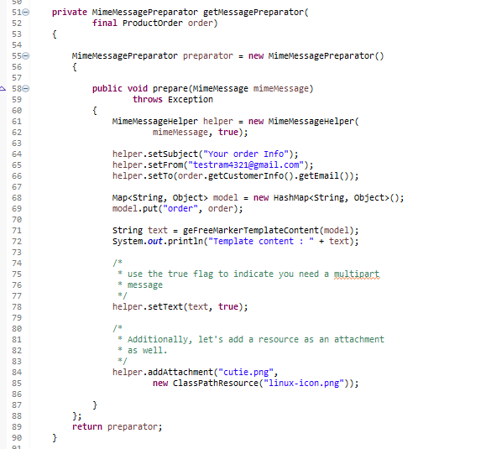
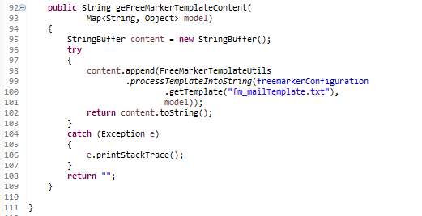
Spring Email using Freemarker Template library

Slide 5
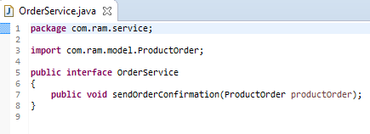
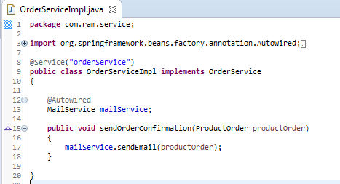
Spring Email using Freemarker Template library

Slide 6
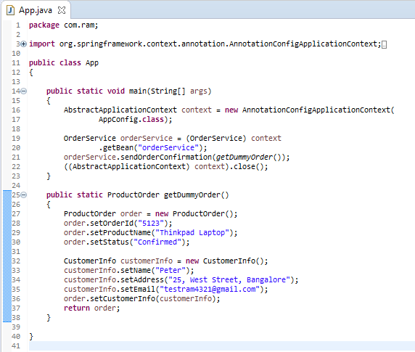
Spring Email using Freemarker Template library

Slide 7
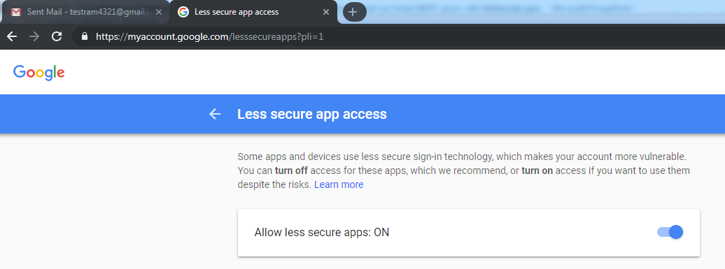
Spring Email using Freemarker Template library
To resolve javax.mail.AuthenticationFailedException is thrown while sending email in java
Go Login from Your browser from that email. I had problem with google if it is google go here :https://www.google.com/settings/security/lesssecureapps
you will see turn off or turn on. Click "Turn on"
Then try your code again it will work

